Slide 1


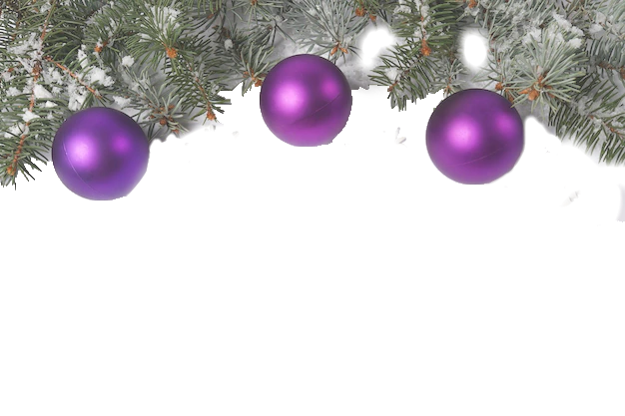


Saturday 12th December 2026
LOTS OF PRIZES AND TREATS FOR EVERYONE
Best Festive Outfit Wins a prize!
Class 1​ North cross poles
All double clears win a rosette, all competitors will be allowed to compete in second round regardless of faults in first round.
Class 2​ Buddy the Elf’s Beginners Novice – cross poles and straights
​​Genuine novices only
Class 3​ Noel’s Nursery Novice – max height in first round 40cm
​​No combination to have won three firsts,
Class 4. THE CHRISTMAS ELVES’ PAIRS RELAY
1ST RIDER JUMPS 1ST HALF OF COURSE AT 50 CM THEN THE 2ND RIDER WHO JUMPS 2ND HALF AT 70CM
Class 5 Nativity Novice – max height in first round 50cm,
Class 6 Polar Bears Progressive – max height in first round 60cm,
Class 7 Icy Intermediate – max height in first round 70cm,
Includes Pony Club Foundation Preliminary Qualifier
Class 8 Santa’s Small Open – max height in first round 80cm
Includes Pony Club Debut Preliminary Qualifier
Class 9 Olaf’s Open – max height in first round 90cm,
Includes Pony Club Challenge Preliminary Qualifier
Class 10 Grinch’s Grand Prix. First round 1m
Bottle of prosecco to the senior winner (18+)
Entry WKRC members £9 non members £10
WWW.WESTKYPEFARM.COM
CONDITIONS OF PARTICIPATION AT SHOW
1. All riders must abide by British Showjumping/British Dressage rules at all times
2. Traditional style riding boots must be worn
3. Riding hats of approved standard must be worn
4. Smart show attire
5. WKRC, it’s officials and those working for it disclaim any responsibility for any accident to persons, animals, property, howsoever caused, while on its premises
6. No dogs allowed out of vehicle

